Slide 1
Mathematics (9-1) - iGCSE
2018-20
Year 09
Unit 10 – Answers

Slide 2
10 - Prior knowledge check
Page 665
a. 0.97 b. 0.85 c. 0.35 d. 0.38
a. 0.78 b. 0.24 c. $\frac{2}{5}$ d. $\frac{7}{12}$ e. 73% f. 32%
a. $\frac{2}{8}$, $\frac{3}{12}$, $\frac{4}{16}$, etc. b. $\frac{4}{10}$, $\frac{6}{15}$, $\frac{8}{20}$, etc. c. $\frac{10}{12}$, $\frac{15}{18}$, $\frac{20}{24}$, etc. d. $\frac{14}{20}$, $\frac{21}{30}$, $\frac{28}{40}$, etc.
$\frac{2}{7}$ $\frac{1}{3}$ $\frac{3}{8}$ $\frac{2}{5}$ $\frac{5}{12}$

Slide 3
10 - Prior knowledge check
Page 665
a. 40 b. 24 c. 26.4 d. 508 e. 300 f. 126
a. 0.25m, 25% b. 0.3m, 30% c. 0.6m, 60% d. 0.365m, 37.5% e. 0.85m, 85% f. 0.4625m, 46.25%
a. 68 b. 81.9 c. 205 d. 4.2

Slide 4
10 - Prior knowledge check
Page 665
a. $\frac{11}{12}$ b. $\frac{23}{30}$ c. $\frac{7}{12}$ d. $\frac{13}{84}$
b. 100 c. $\frac{39}{50}$, $\frac{17}{100}$, $\frac{1}{10}$ d. 234

Slide 5
10 - Prior knowledge check
Page 665
a. 1, 2, 3, 4, 5, 6 b. $\frac{1}{6}$ c. 1
a. $\frac{1}{4}$ b. 25 times c. $\frac{7}{25}$
a.
$\frac{5}{16}$ c. $\frac{9}{16}$
0.55
 | Glasses | No Glasses | Total
Boys | 4 | 10 | 14
Girls | 6 | 12 | 18
Total | 10 | 22 | 32

Slide 6
10.1 – Combined Events
Page 665
a. 8 b. 10 c. 12 d. 18 e. Mn
a. BA, BP, BS, LA, LP, LS, CA, CP, CS, HA, HP, HS, MA, MP, MS b. 15 c. $\frac{1}{15}$ d. $\frac{2}{25}$
a. 10 b. $\frac{2}{5}$ c. $\frac{2}{5}$ d. $\frac{1}{10}$
a. HH, HT, TH, TT b. 4 c. i. $\frac{1}{4}$ ii. $\frac{1}{2}$

Slide 7
10.1 – Combined Events
Page 665
a.
i. $\frac{1}{2}$ ii. $\frac{1}{2}$ iii. 0
a. b. (4, 7)(6, 5)(8, 3) c. $\frac{3}{20}$
 |  | Dice
 |  | 1 | 2 | 3 | 4 | 5 | 6
Spinner | 1 | 2 | 3 | 4 | 5 | 6 | 7
 | 2 | 3 | 4 | 5 | 6 | 7 | 8
 | 3 | 4 | 5 | 6 | 7 | 8 | 9
 | 4 | 5 | 6 | 7 | 8 | 9 | 10
13 | 15
15 | 17

Slide 8
10.1 – Combined Events
Page 665
a.
36 c. i. $\frac{1}{18}$ ii. $\frac{1}{2}$ iii. $\frac{5}{18}$ d. 7
 |  | Dice 1
 |  | 1 | 2 | 3 | 4 | 5 | 6
Dice 2 | 1 | 2 | 3 | 4 | 5 | 6 | 7
 | 2 | 3 | 4 | 5 | 6 | 7 | 8
 | 3 | 4 | 5 | 6 | 7 | 8 | 9
 | 4 | 5 | 6 | 7 | 8 | 9 | 10
 | 5 | 7 | 8 | 9 | 10 | 11 | 12
 | 6 | 8 | 9 | 10 | 11 | 12 | 13

Slide 9
10.1 – Combined Events
Page 665
a.
i. $\frac{1}{12}$ ii. $\frac{1}{4}$ iii. $\frac{3}{4}$
$\frac{1}{8}$
$\frac{3}{5}$
 |  | Bag A
 |  | S | O | L | B
Bag B | S | SS | OS | LS | BS
 | B | SB | OB | LB | BB
 | L | SL | OL | LL | BL

Slide 10
10.2 – Mutually Exclusive Events
Page 666
$\frac{1}{3}$
a. $\frac{1}{3}$ b. $\frac{1}{2}$ c. $\frac{1}{3}$
$\frac{5}{9}$
a and c (a square number and a multiple of 3)
a. $\frac{1}{2}$ b. $\frac{5}{6}$ c. $\frac{2}{3}$
a. $\frac{1}{2}$ b. $\frac{15}{52}$
23%

Slide 11
10.2 – Mutually Exclusive Events
Page 666
$\frac{4}{5}$
a. 0.4 b. 0.9
a. $\frac{1}{6}$ b. $\frac{5}{6}$
a. $\frac{1}{4}$ b. $\frac{3}{4}$
0.12
0.15
$\frac{7}{9}$
0.35
0.62

Slide 12
10.3 – Experimental Probability
Page 666
a. 15 b. 140 c. 70 d. 120
a. < b. < c. > d. >
a. 50 b. i. $\frac{43}{50}$ ii. $\frac{7}{50}$ c. 86
Betty, the greater the number of trials, the better the estimate.
a. $\frac{3}{8}$ b. 150

Slide 13
10.3 – Experimental Probability
Page 666
a. $\frac{5}{12}$ b. 75
18
a. 0.23, 0.22, 0.21, 0.18, 0.09, 0.07
0.07 c. 35
No, a fair dice has a theoretical probability of 0.17 for each outcome. For this dice, the estimated probability of rolling a 1 is more than three times more likely than rolling a 6.

Slide 14
10.3 – Experimental Probability
Page 666
Yes, because the estimated probabilities of 0.23,0.195,0.185, 0.2,0.19 are all dose to the theoretical probability of 0.2
40
No. Assuming there are more than 200 tickets in the draw, there will be more than 200 tickets that do not win, so buying 200 tickets will not guarantee a prize.

Slide 15
10.3 – Experimental Probability
Page 666
a. 5 b. 30 c. 75
The dentist’s estimate is a little high. The results from the 160 patients suggest a probability of 0.156

Slide 16
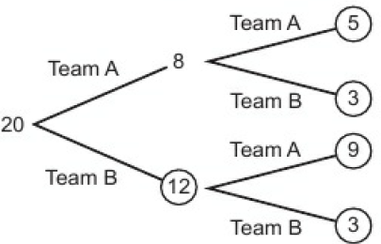
10.4 – Independent Events and tree Diagram
Page 666
a. $\frac{7}{45}$ b. $\frac{5}{12}$ c. $\frac{13}{28}$ d. 0.08 e. 0.42 f. 0.44

Slide 17
10.4 – Independent Events and Tree Diagram
Page 666
a. $\frac{7}{45}$ b. $\frac{5}{12}$ c. $\frac{13}{28}$ d. 0.08 e. 0.42 f. 0.44

Slide 18
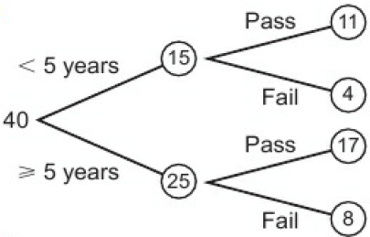
10.4 – Independent Events and Tree Diagram
Page 666
a. b. $\frac{3}{10}$

Slide 19
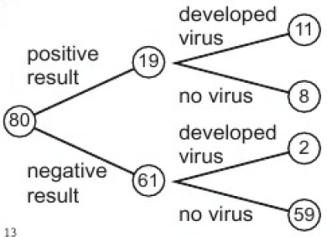
10.4 – Independent Events and Tree Diagram
Page 666
a. b. $\frac{13}{80}$

Slide 20
10.4 – Independent Events and Tree Diagram
Page 666
0.24
a. 0.55 b. 0.65 c. 0.375
a. $\frac{1}{4}$ b. $\frac{1}{16}$ c. $\frac{5}{52}$ d. $\frac{1}{676}$ e. $\frac{1}{2704}$
$\frac{27}{125}$

Slide 21
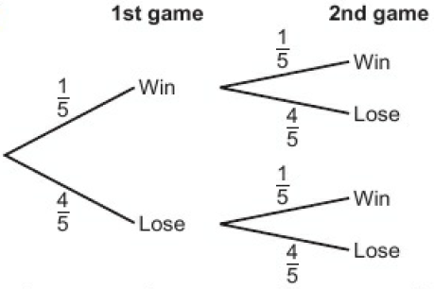
10.4 – Independent Events and Tree Diagram
Page 666
a. b. i. $\frac{1}{4}$ ii. $\frac{16}{25}$ iii. $\frac{8}{25}$ iv. $\frac{9}{25}$

Slide 22
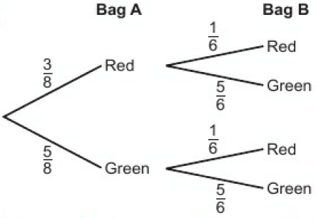
10.4 – Independent Events and Tree Diagram
Page 666
a. b. i. $\frac{7}{12}$ ii. $\frac{5}{12}$ iii. $\frac{25}{48}$ iv. $\frac{23}{48}$

Slide 23
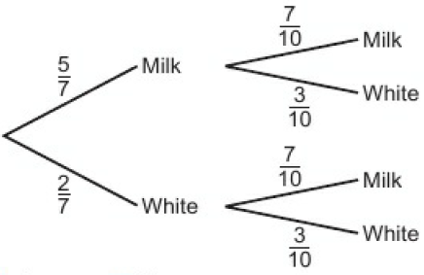
10.4 – Independent Events and Tree Diagram
Page 666
a. b. i. $\frac{1}{2}$ ii. $\frac{29}{70}$

Slide 24
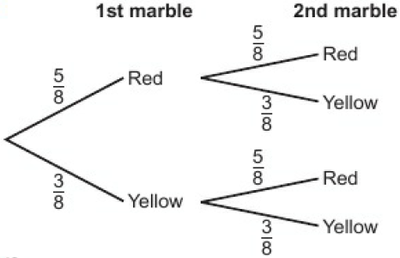
10.4 – Independent Events and Tree Diagram
Page 667
a. b. $\frac{15}{32}$

Slide 25
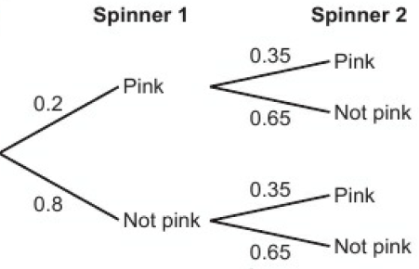
10.4 – Independent Events and Tree Diagram
Page 667
a. b. 0.41 c. 0.07 d. 35

Slide 26
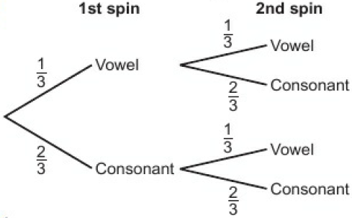
10.5 – Conditional Probability
Page 667
a. b. $\frac{1}{9}$

Slide 27
10.5 – Conditional Probability
Page 667
a. $\frac{47}{130}$ b. $\frac{87}{130}$ c. $\frac{23}{60}$
a. dependent b. independent c. independent d. dependent e. independent
a. 0.04 b. 0.03 c. 0.91

Slide 28
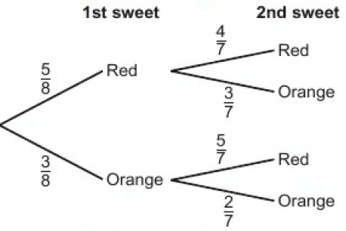
10.5 – Conditional Probability
Page 667
a. b. i. $\frac{13}{28}$ ii. $\frac{15}{28}$ iii. $\frac{10}{28}$
11.25%
0.7875

Slide 29
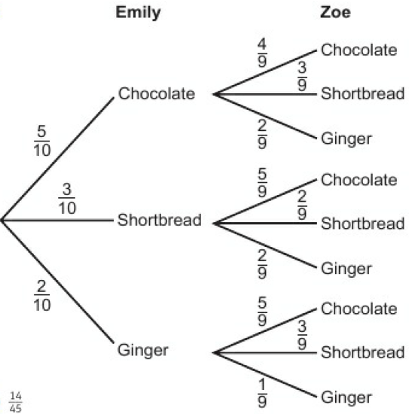
10.5 – Conditional Probability
Page 667
a. b. $\frac{14}{45}$

Slide 30
10.5 – Conditional Probability
Page 667
$\frac{35}{66}$
$\frac{10}{36}$
$\frac{14}{45}$

Slide 31
10.6 – Venn Diagrams & Probability
Page 667
a. 2 b. 32 c. 17 d. 100
a. A = {2, 4, 6, 8}; B = {2, 3, 5, 7} b. i. true ii. false iii. true
a. {1, 3, 5, 7, 9, 11, 13, 15} b. {1, 4, 9} c. {1, 2, 3, 4, 5, 6, 7, 8 9, 10, 11, 12, 13, 14, 15} d. Q e. P: odd umbers < 16; ξ: positive numbers < 16

Slide 32
10.6 – Venn Diagrams & Probability
Page 667
a. {1, 3, 4, 5, 7, 9, 11, 13, 15} b. {1, 9} c. {2, 4, 6, 8, 10, 12, 14} d. {2, 3, 5, 6, 7, 8, 10, 11, 12, 13, 14, 15} e. {4} f. {3, 5, 7, 11, 13, 15}
a. $\frac{5}{12}$ b. $\frac{1}{2}$ c. $\frac{1}{12}$ d. $\frac{5}{6}$ e. $\frac{7}{12}$ f. $\frac{1}{2}$ g. $\frac{1}{3}$ h. $\frac{2}{3}$

Slide 33
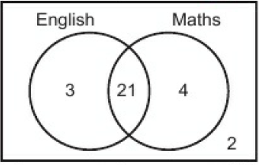
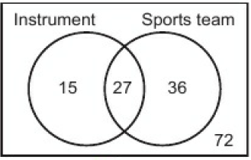
10.6 – Venn Diagrams & Probability
Page 667
a. b. i. $\frac{4}{5}$ ii. $\frac{7}{10}$ iii. $\frac{14}{15}$ iv. $\frac{2}{15}$
a. b. $\frac{7}{25}$ c. $\frac{3}{7}$

Slide 34
10.6 – Venn Diagrams & Probability
Page 667
a. 120 b. i. $\frac{31}{60}$ ii. $\frac{7}{24}$ iii. $\frac{22}{47}$
a. 7 b. 40 c. i. $\frac{7}{40}$ ii. $\frac{11}{40}$ iii. $\frac{11}{13}$

Slide 35
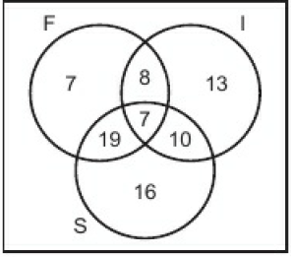
10.6 – Venn Diagrams & Probability
Page 668
a. b. $\frac{13}{40}$ c. $\frac{1}{2}$

Slide 36
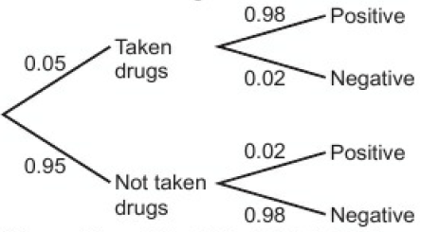
10 – Problem Solving
Page 668
a. False positives: 0.95 x 0.02 = 0.019 (= 1.9%)

Slide 37
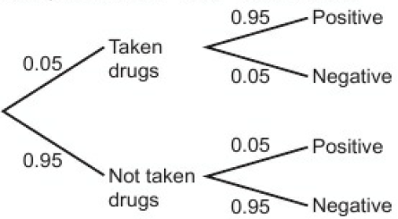
10 – Problem Solving
Page 668
a.
True positive: 0.05 x 0.95 = 0.0475 False positive: 0.95 x 0.05 = 0.0475 There would be the same amount of false positives as genuine positive results. This means that half the people that received positive results would be innocent.

Slide 38
10 – Problem Solving
Page 668
Students may have different argument to make. Probability of positive for test A = 005 > 0.98 + 0.95 x 002 = 0.068 Number of retests = 600 x 0.068 = 41 Cost = 641 x £52 = £33332 Probability of positive for test B = 0.05 x 0.95 + 0.95 x 0.05 = 0.095 Number of retests = 600 x 0.095 = 57 Cost = 657 x £40 = £26280 It would be significantly cheaper to use test B. However we have shown that for test B, 4.75% of results are a false positive. So this could result in at least one of the retests giving a false positive.

Slide 39
10 – Check Up
Page 668
a. 0.75 b. 0.075
a. $\frac{4}{5}$ b. $\frac{7}{10}$
a.
 |  | Dice
 |  | 1 | 2 | 3 | 4 | 5 | 6
Spinner | 2 | 3 | 4 | 5 | 6 | 7 | 8
 | 4 | 5 | 6 | 7 | 8 | 9 | 10
 | 6 | 7 | 8 | 9 | 10 | 11 | 12
 | 8 | 9 | 10 | 11 | 12 | 13 | 14

Slide 40
10 – Check Up
Page 668
$\frac{2}{17}$
0.15
a.
45
No, the probabilities are different. If the spinner was fair the probabilities would all be the same.
Number | 1 | 2 | 3 | 4 | 5 | 6
Frequency | 0.2 | 0.3 | 0.1 | 0.15 | 0.1 | 0.15

Slide 41
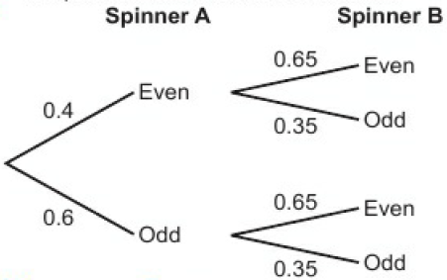
10 – Check Up
Page 668
a. b. i. 0.21 ii. 0.53

Slide 42
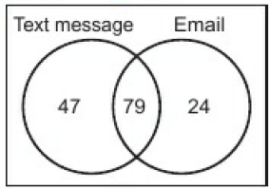
10 – Check Up
Page 668
a. b. $\frac{93}{140}$ c. $\frac{79}{126}$
a. R = {2, 3, 5, 8} b. R’ = {1, 4, 6, 7, 9, 10} c. R ∩ S = {3, 5} d. ξ = {1, 2, 3, 4, 5, 6, 7, 8, 9, 10} e. Yes
Students’ own answers.

Slide 43
10 – Strengthen
Page 668
Calculating probability
a. $\frac{1}{5}$ b. $\frac{4}{5}$ c. $\frac{4}{6}$ d. The answers are the same. e. i. $\frac{3}{10}$ b. $\frac{7}{10}$
a. $\frac{1}{10}$ b. $\frac{3}{10}$ c. $\frac{2}{5}$ d. The total of answers to parts a and b is the answer to part c. e. $\frac{1}{2}$

Slide 44
10 – Strengthen
Page 668
0.15
a. b. 9 c. $\frac{1}{9}$ d. (W, W), (D, W), (L, W), (W, D) or (W, L) e. $\frac{5}{9}$
 |  | 1st Match
 |  | Win | Draw | Lose
2nd Match | Win | W, W | D, W | L, W
 | Draw | W, D | D, D | L, D
 | Lose | W, L | D, L | L, L

Slide 45
10 – Strengthen
Page 668
a. 25 outcomes
i. $\frac{2}{5}$ ii. $\frac{8}{25}$ c. two even numbers
 |  | Spinner A
 |  | 2 | 2 | 4 | 4 | 6
Spinner B | 1 | 2, 1 | 2, 1 | 4, 1 | 4, 1 | 6, 1
 | 2 | 2, 2 | 2, 2 | 4, 2 | 4, 2 | 2, 1
 | 2 | 2, 2 | 2, 2 | 4, 2 | 4, 2 | 2, 1
 | 3 | 2, 3 | 2, 3 | 4, 3 | 4, 3 | 2, 1
 | 3 | 2, 3 | 2, 3 | 4, 3 | 4, 3 | 2, 1

Slide 46
10 – Strengthen
Page 669
d.
5 ii. $\frac{13}{25}$
a. 77 b. $\frac{41}{77}$
 |  | Spinner A
 |  | 2 | 2 | 4 | 4 | 6
Spinner B | 1 | 3 | 3 | 5 | 5 | 7
 | 2 | 4 | 4 | 6 | 6 | 8
 | 2 | 4 | 4 | 6 | 6 | 8
 | 3 | 5 | 5 | 7 | 7 | 9
 | 3 | 5 | 5 | 7 | 7 | 9

Slide 47
10 – Strengthen
Page 669
a. $\frac{10}{19}$; multiply and add b. $\frac{3}{10}$; add c. $\frac{14}{95}$; multiply c. $\frac{3}{10}$; add
Experimental Probability
a. $\frac{1}{20}$ b. 25 c. 36
a. 30
No, as the expected number is double the amount thay Dylan did get.

Slide 48
10 – Strengthen
Page 669
a. $\frac{1}{5}$, $\frac{3}{20}$, $\frac{7}{40}$, $\frac{17}{80}$, $\frac{21}{80}$ b. 30
Tree Diagrams and Venn Diagrams
a. without replacement b. with replacement c. without replacement

Slide 49
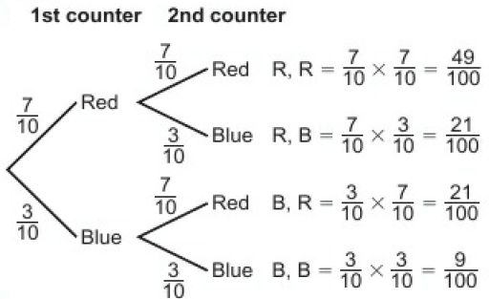
10 – Strengthen
Page 669
a. b. $\frac{21}{50}$

Slide 50
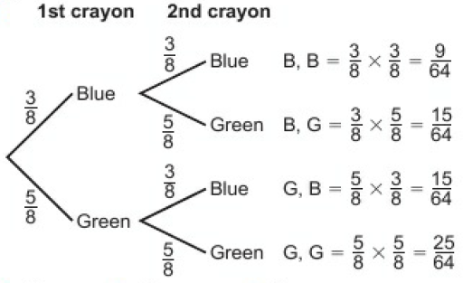
10 – Strengthen
Page 669
a. b. i. $\frac{15}{32}$ ii. $\frac{25}{64}$ iii. $\frac{55}{64}$

Slide 51
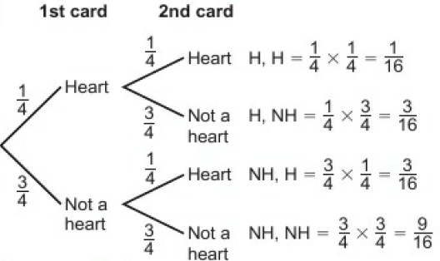
10 – Strengthen
Page 669
a. b. $\frac{1}{16}$ c. $\frac{3}{8}$

Slide 52
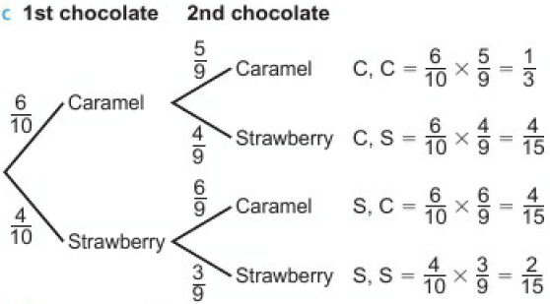
10 – Strengthen
Page 669
a. $\frac{3}{5}$ b. $\frac{5}{9}$ c. d. i. $\frac{8}{15}$ ii. $\frac{2}{3}$

Slide 53
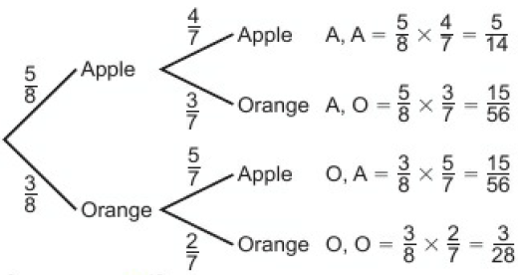
10 – Strengthen
Page 669
a. b. $\frac{3}{28}$ c. $\frac{15}{28}$

Slide 54
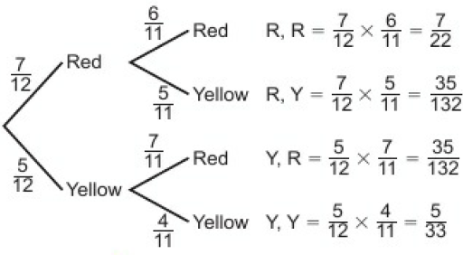
10 – Strengthen
Page 669
a. b. $\frac{31}{66}$ c. $\frac{35}{132}$

Slide 55
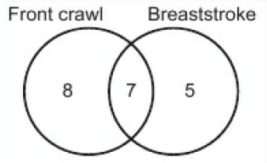
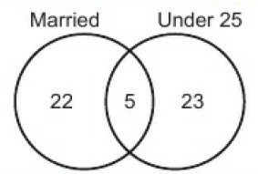
10 – Strengthen
Page 669
a. i, ii and iii. b. 20 c. i. $\frac{7}{20}$ ii. $\frac{2}{5}$ d. $\frac{7}{15}$
a. b. $\frac{27}{50}$ c. $\frac{5}{28}$

Slide 56
10 – Strengthen
Page 669
a. i. {50, 75, 100, 150) ii. (100, 150, 200, 250, 300) iii. {50, 75, 100, 150, 200, 250, 300} iv. (100, 150) v. {50, 75, 100, 125, 150, 175, 200, 225, 250, 275, 300) b. i. 200 ϵ B ii. 175 ϵ ξ iii. 100 ϵ A ∩ B

Slide 57
10 – Extend
Page 670
Any multiple of: 2 red, 2 green, 5 blue and 1 yellow.
Example: If both cards are the same colour, both players turn over the next card. The winner is the first person to turn over a red card when the other player has turned over a black card. Check that any rule given by the student gives the same probability for player A and player B

Slide 58
10 – Extend
Page 670
a. 0.35 b. 20
a. i. 24% ii. 32% b. 111 days c. 19.36%
$\frac{1904}{4495}$
$\frac{8}{25}$

Slide 59
10 – Extend
Page 670
a. $\frac{5}{14}$ b. $\frac{1}{28}$ c. $\frac{2}{7}$
a. $\frac{1}{12}$ b. $\frac{1}{12}$ c. $\frac{5}{96}$ d. $\frac{5}{96}$
51
$\frac{27}{45}$
a. A ∪ B b. B’ ∪ A c. B ∩ C ∩ A’

Slide 60
10 – Unit Test
Page 670
Sample student answer
Labels to show the flavour each branch represents are missing from the tree diagram.
Labels to show the combination that each calculation represents are missing.
There should be a sentence to clearly state the answer to the question.

